Slide 1
Group No.06
Opinion mining on Russia – Ukraine conflicts in
social media - Twitter
BY
Sumesh Sonawane

Slide 2
Opinion mining on Russia – Ukraine conflicts in
social media - Twitter
Russia Tweets
Ukraine Tweets
.
2022
2023
01
02
03
04
05
06
07
08
09
10
11
12
75
120
34
109

Slide 3
Opinion mining on Russia – Ukraine conflicts in
social media - Twitter
The Ongoing conflicts between Russia and Ukraine have significant global attention and social media platforms like Twitter have become popular avenue for expressing public sentiment and opinions on the matter.
This project focuses on sentiment analysis of Twitter data related to the Russia-Ukraine conflict. We aim to predict public sentiment through various steps, language analysis, hashtag tracking, including tokenization and sentiment classification & by creating a machine learning model.
Russia – Ukraine Conflicts

Slide 4
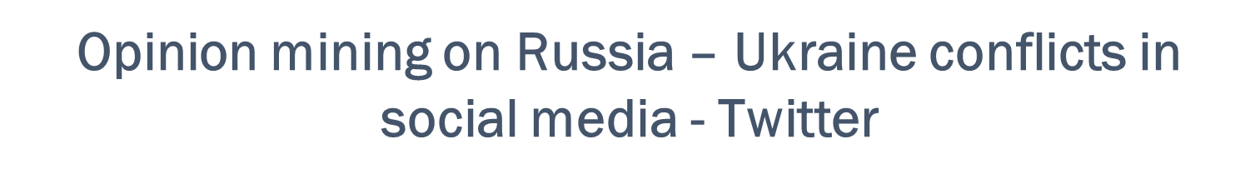
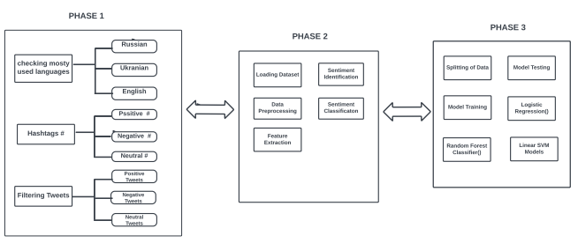
Fig – Block Diagram

Slide 5
Roadmap of Project
Tweets By Sentiments (Positive, Negative and Neutral)
Importing various Library
Preprocessing The Dataset
Sentiment Score Generate all tweets
1
3
5
5
2
4
6
Load Big Dataset
Visualize Tweets Frequency by Date
Comparison Positive and Negative Hashtags #

Slide 6
Opinion mining on Russia – Ukraine conflicts in
social media - Twitter
Filtering Dataset
Check Which Language is Mostly Used (e.g. English, Ukrainian, Russian)
First Step
Data Preprocessing
Second Step
Data Cleaning (Remove Patterns , Removal Stop words), Tokenization, Stemming.
Data Modeling
Create Logistics regression, Random Forest model and Linear SVM
Third Step
Deep Learning
Fourth Step
Create Sequential model, LSTM model

Slide 7
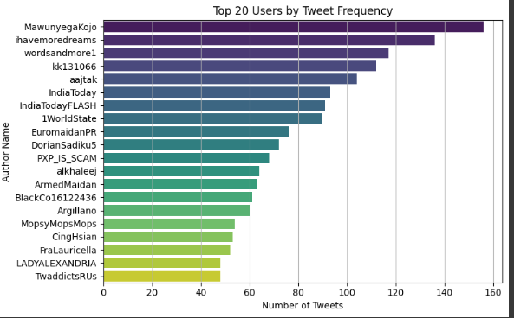
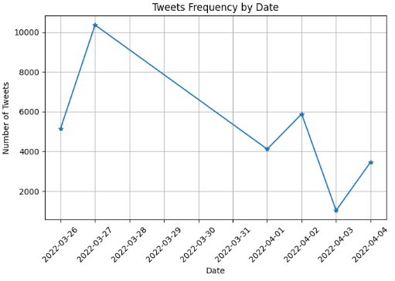
20%
50%
80%
60%
January
February
March
April
Visualize Tweets Frequency by Date.
Plot the Distribution of top 20 Languages.
Check the Distribution of Tweet Lengths.
Visualize top 20 users by Tweet Frequency.
85%
54%
35%
English
Ukrainian
Russian

Slide 8
Opinion mining on Russia – Ukraine conflicts in social media - Twitter
# Hashtags
#Negative 08%
#Positive 52%
Collect Positive and Negative # Hashtags.
Visualize and Compared Positive and Negative .
Check most common # Hashtags.
Clean Duplicates and Similar Hashtags.
#Similar 15%
Growth 0,011%

Slide 9
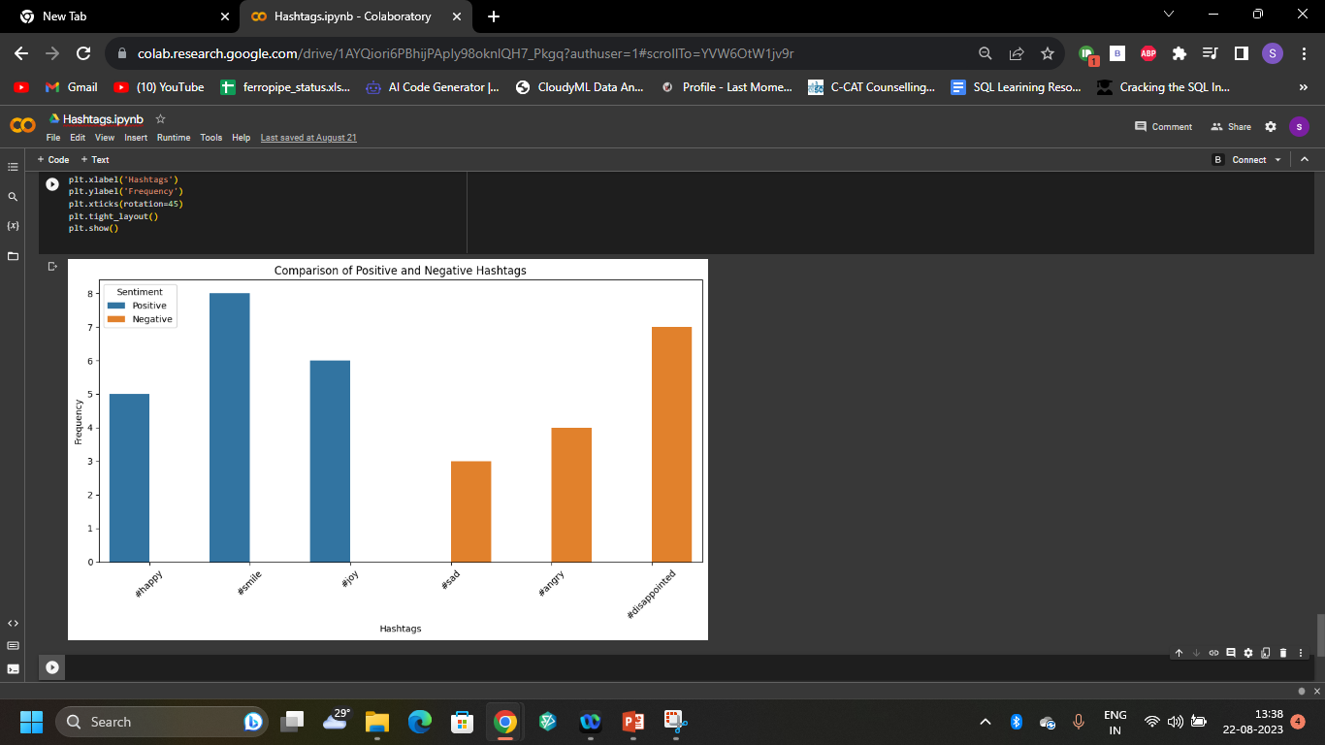
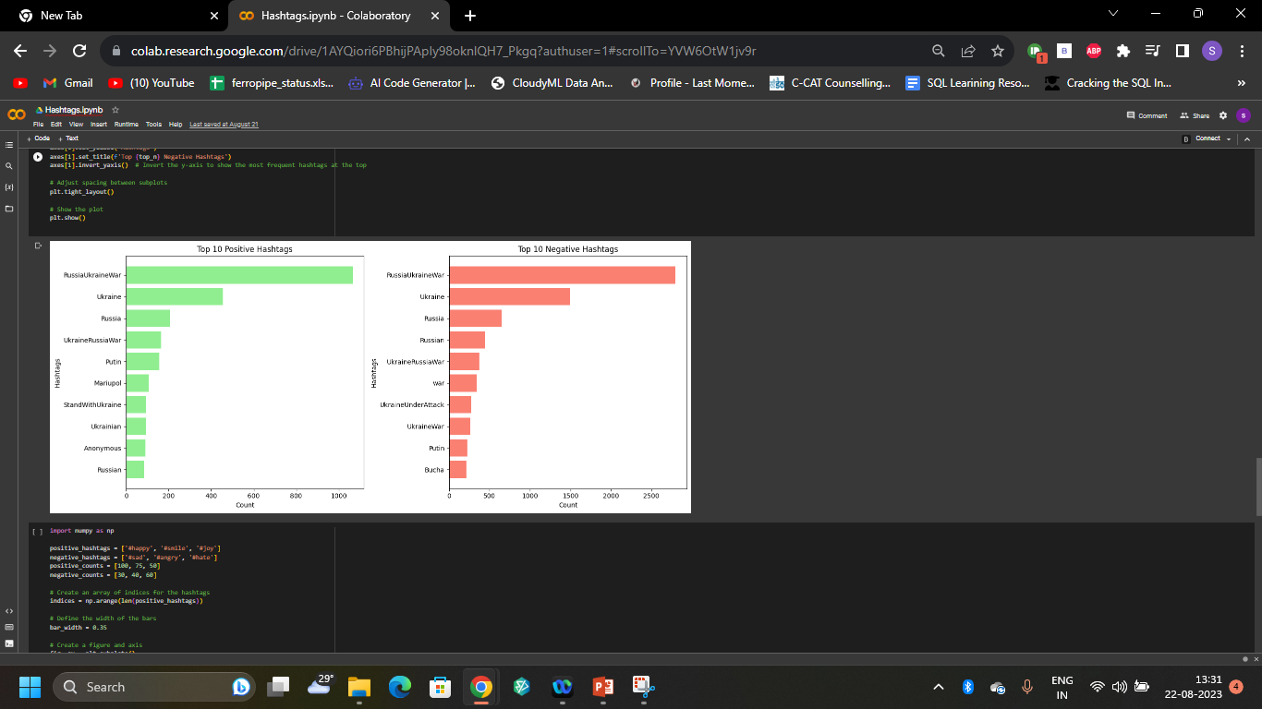
#Positive 75%
#Negative 65%

Slide 10
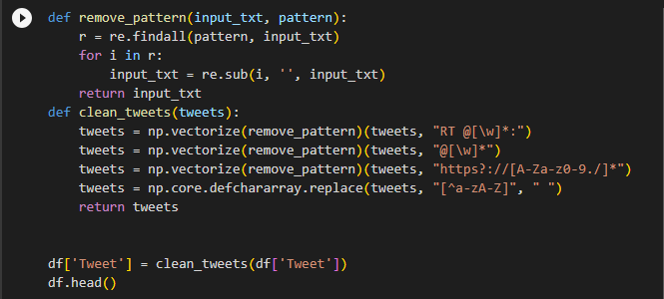
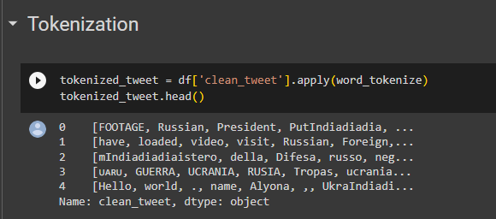
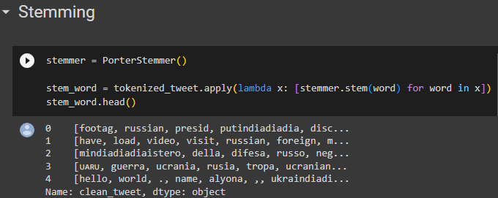
Data Preprocessing
Cleaning Tweets (Remove Patterns)
Remove Short Words, Remove Stop Words.
Tokenization
Stemming.

Slide 11
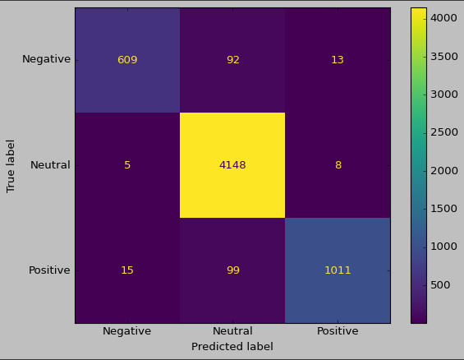
Showing Count and Percentage of Tweets by Sentiment
Sentiments | Counts | Percentage
Negative | 3510 | 11.700000
Neutral | 20729 | 69.096667
Positive | 5761 | 19.203333

Slide 12
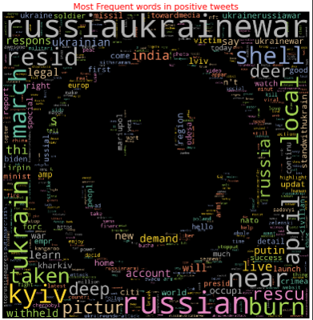
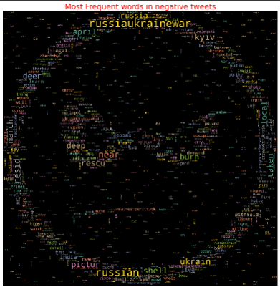
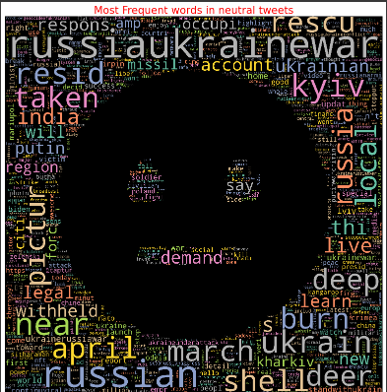
Word Clouds of Sentiments
Positive
Neutral
Negative

Slide 13
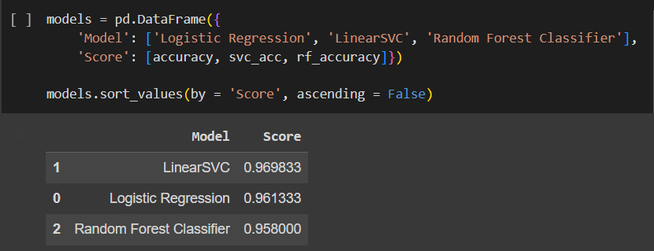
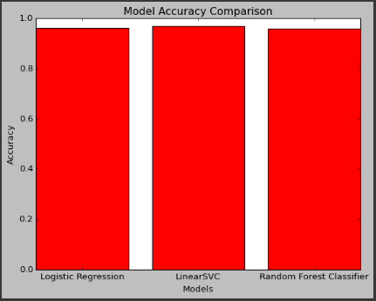
Opinion mining on Russia – Ukraine conflicts in social media - Twitter
Machine Learning Modeling
Logistic Regression
Random Forest
Linear SVC

Slide 14
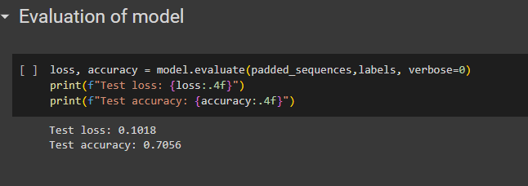
Opinion mining on Russia – Ukraine conflicts in social media - Twitter
Deep Learining
Low
High
analysis
0.00
0.80

Slide 15
Opinion mining on Russia – Ukraine conflicts in social media - Twitter
Challenges Faced
Extracting Data From Large Twitter Dataset
Checking which Languages mostly used in dataset
Check most # Hashtags (Neutral, Positive, Negative).
Sentiment Analysis (Neutral, Positive, Negative).
Creating Data Models (Logistic Regression, Random Forest, Linear SVM)
Creating Deep Learning Model

Slide 16
Opinion mining on Russia – Ukraine conflicts in social media - Twitter
References
15%
Ashraf I, Kang M, Hur S, Park Y. MINLOC: magnetic Feld patterns-based
indoor localization using convolutional neural networks. IEEE Access. 2020;8:66213.
Štrimaitis R, Stefanovič P, Ramanauskaitė S, Slotkienė A. Financial context news
sentiment analysis for the lithuanian language. Appl Sci. 2021;11(10):4443
50%
25%
10%

Slide 17
Thank You

